Slide 1
Detecting Process
Based on OpenCV

Slide 2
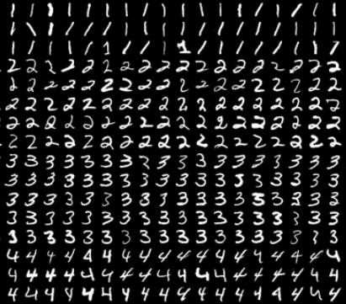
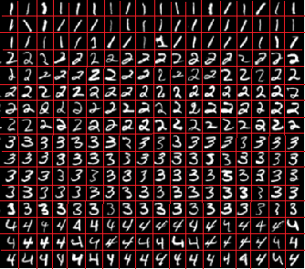
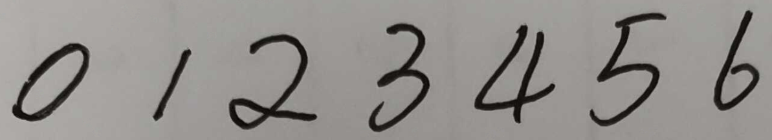
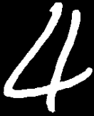
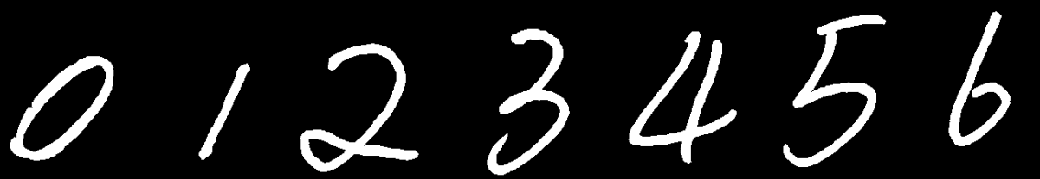

Analyze
[[0 0 0 0 0 0 0 0]
[0 0 1 1 1 0 0 0]
[0 1 0 0 0 1 0 0]
[0 0 0 1 1 0 0 0]
[0 0 0 0 0 1 0 0]
[0 1 0 0 0 1 0 0]
[0 0 1 1 1 0 0 0]]
trainData
[0 0 0 0 0 0 0 0 0 0 1 1 1 0 0 0...0]
x.reshape()
Reference
trainLabels: 3
np.arange(10)
np.repeat()[:,np.newaxis]
digits.png 50x100
cv2.imread()
np.vsplit()
np.hsplit()
cells
x=np.array(cells)
knn = cv2.ml.KNearest_create()
knn.train()
To be tested
imgData
[0 0 0 0 0 0 1 1 0 0 1 1 1 0 0 0...0]
Image Preprocessing
Image segmentation
Resize
cv2.resize()
Reshape
img.reshape()

Slide 3
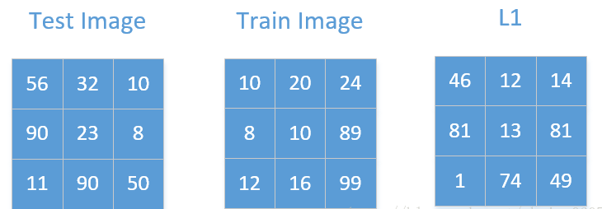

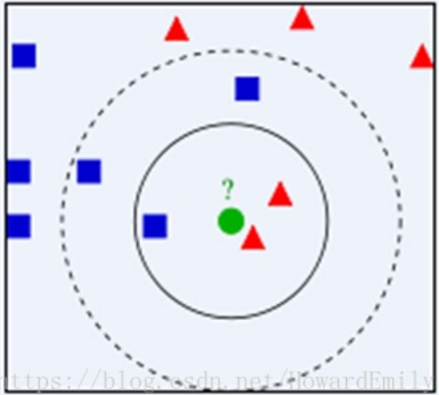
imgData
[0 0 0 0 0 0 1 1 0 0 1 1 1 0 0 0...0]
To be tested
trainLabels
[[0]
[1]
[2]
[3]
[4]
[5]
[6]
[7]
[8]
[9]]
trainData
[[0 0 0 0 0 0 1 1 1 1 1 1 1 0 0 0...0]
[0 0 0 0 0 0 0 0 1 1 1 0 0 0 0 0...0]
[0 0 0 0 0 0 0 1 1 1 1 1 0 0 0 0...0]
[0 0 0 0 0 0 1 1 1 1 1 1 0 0 0 1...0]
[0 0 0 0 0 0 1 1 0 0 1 1 1 0 0 0...0]
[0 0 0 0 0 0 1 1 0 0 0 0 0 0 0 0...0]
[0 0 0 0 0 0 0 0 0 1 1 1 1 0 0 0...0]
[0 0 0 0 0 0 1 1 1 1 1 1 1 1 1 0...0]
[0 0 0 0 0 0 1 1 1 1 1 1 0 0 0 1...0]
[0 0 0 0 1 1 1 1 1 1 1 1 1 0 1 1...0]]
Reference
knn.findNearest()
Output
outPut
[4]
Process of kNN
Notes:
The algorithm caches all training samples and predicts the response for a new sample by analyzing a certain number (K) of the nearest neighbors of the sample using voting, calculating weighted sum, and so on. The method is sometimes referred to as "learning by example" because for prediction it looks for the feature vector with a known response that is closest to the given vector.
计算两个图像之间差异性的方法有很多，比如曼哈顿距离(p=1)、欧氏距离(p=2)和切比雪夫距离(p趋于无穷大)。这里以曼哈顿距离为例。

Slide 4
Get the Single Number
[[0 0 0 0 0 0 0 0 0]
[0 0 0 1 1 1 0 0 0]
[0 0 1 0 0 0 1 0 0]
[0 0 0 0 1 1 0 0 0]
[0 0 0 0 0 0 1 0 0]
[0 0 1 0 0 0 1 0 0]
[0 0 0 1 1 1 0 0 0]
[0 0 0 0 0 0 0 0 0]]
startRow
endRow
import numpy as np
np.count_nonzero()
startCol
endCol

